Slide 1
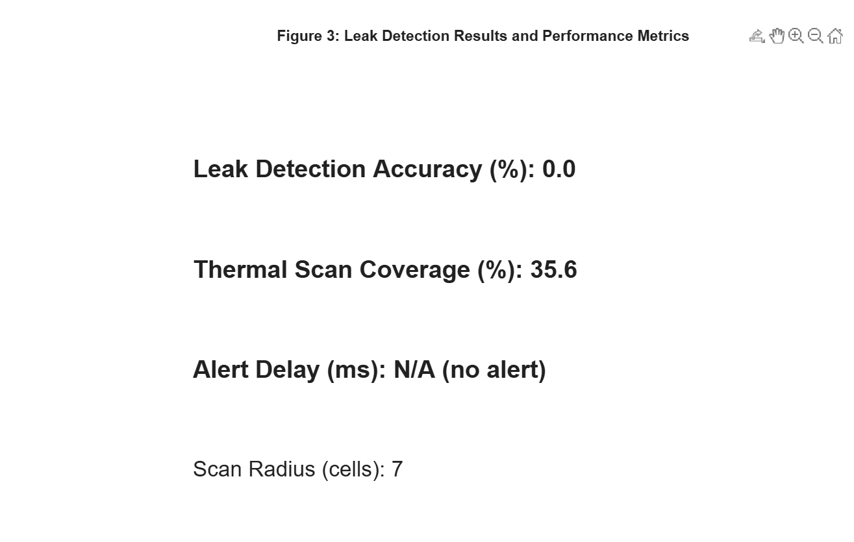
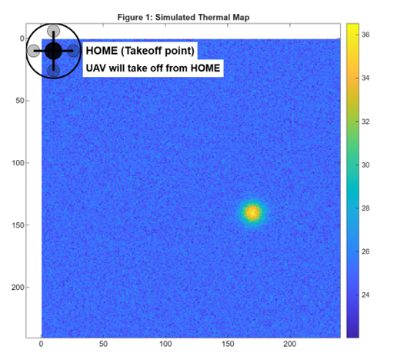
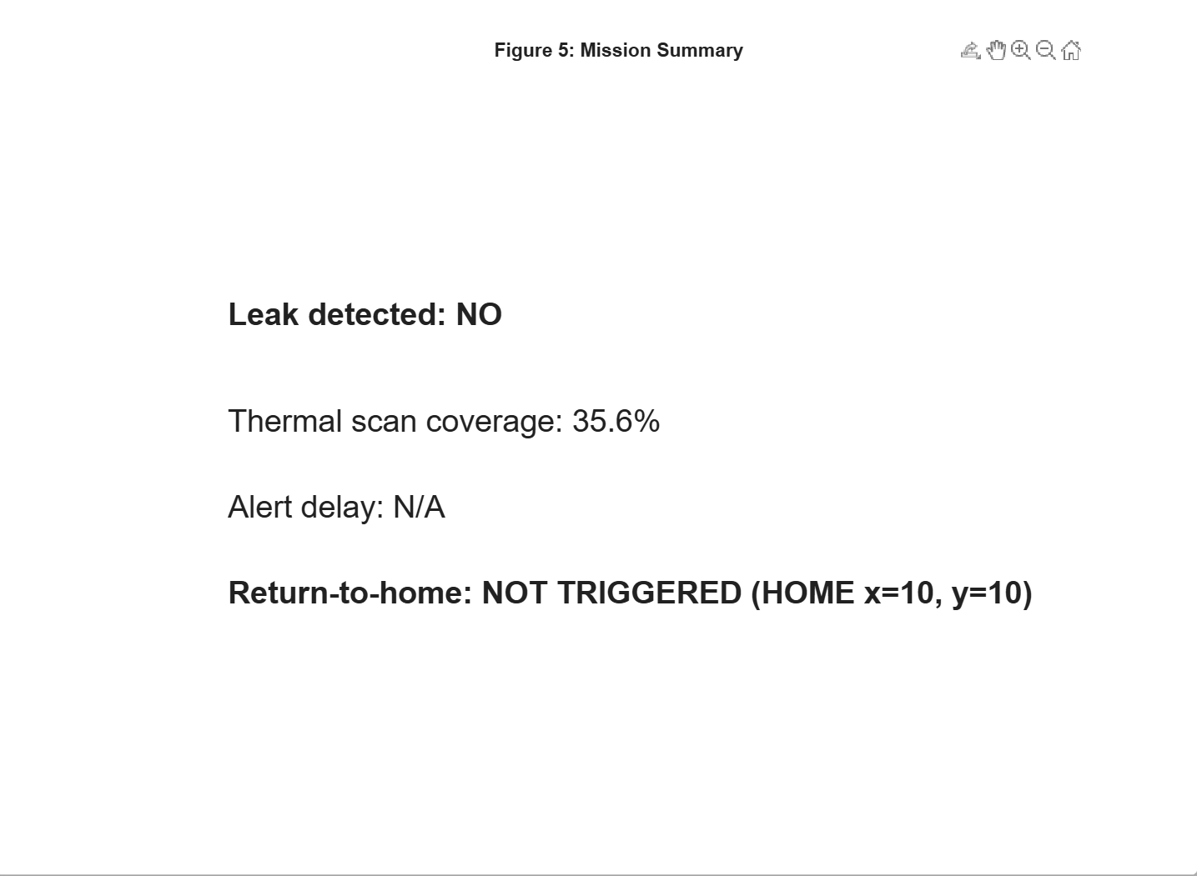

Real-Time Drone Inspection for Irrigation Pipeline Leaks
ID: 223037886
ID: 223031191
ID: 223003831
Authors: Saud Alsaleh & Khaled Alqahtani & Abdulrhman Aldossary
King Faisal University, computer network department
Abstract
Water leakage in irrigation pipelines causes major water loss, especially in arid regions like Al-Ahsa. This work presents a MATLAB-based UAV simulation with a thermal sensor to detect leaks in real time. Results show effective leak detection, high coverage, and timely alerts, offering a scalable solution for agricultural monitoring.
Keywords: UAV inspection, thermal imaging, irrigation pipelines, leak detection, MATLAB simulation
IV. Experiments
In this study, a MATLAB-based simulation was conducted to evaluate the UAV-based pipeline leak detection system. The experiment followed these steps:
Mapping of pipeline paths and UAV waypoints: The irrigation pipeline layout was mapped using predefined coordinates, and waypoints were assigned to ensure complete coverage of the inspection area.
Simulation of thermal environment with leak anomalies: The thermal environment was modeled with ambient temperature variations and Gaussian hotspots representing potential leaks. This allowed testing the system under realistic environmental conditions.
UAV navigation and data collection: The UAV performed an autonomous lawnmower scanning pattern over the pipeline corridor, continuously capturing thermal data from the simulated sensor.
Real-time leak detection and alert generation: Thermal data were analyzed in real time to identify anomalies. When a potential leak was detected, alerts were generated indicating the location and time of the detection.
Mission evaluation: The UAV’s coverage, detection performance, and alert timing were monitored to assess the effectiveness of the system and identify trade-offs between scanning speed and detection accuracy.
I. Introduction
Efficient irrigation is critical in arid agriculture. Underground leaks are hard to detect with manual methods. UAVs with thermal sensors provide rapid, non-invasive inspection by detecting surface temperature anomalies.
II. Principle
The proposed research is based on detecting underground irrigation pipeline leaks by observing surface temperature anomalies. Water leaks cause local changes in soil moisture and temperature, which propagate to the surface. A UAV equipped with a thermal sensor scans the pipeline area using a lawnmower pattern. Thermal data is analyzed in real time, and any detected anomalies trigger alerts indicating potential leak locations. This approach provides a non-invasive, rapid, and scalable method for pipeline monitoring in agricultural environments.
Applicable Conference Topics:
Mechatronics
Control and Measurement
Computing and Informatics
Fig. 3. T. Leak detection results and performance metrics obtained from the MATLAB simulation, including detection accuracy, thermal scan coverage, alert delay, and sensor scan radius.
III. Theoretical Modelling
UAV: Simulated quadrotor with waypoint navigation.
Thermal Sensor: Captures surface temperature; leaks modeled as Gaussian hotspots.
Environment: Ambient temperature with stochastic noise; UAV footprint analyzed for anomalies.
V. Results and Analyses
The simulation results demonstrate that the UAV-based inspection system can effectively detect thermal anomalies associated with irrigation pipeline leaks. High scan coverage was achieved using the lawnmower scanning strategy, ensuring most regions of interest were inspected.
Timely alerts indicate that the system can provide real-time leak detection, minimizing water loss and operational delays. Analysis shows a trade-off between UAV speed and detection accuracy: increasing speed reduces mission time but may lower reliability, while larger sensor footprints improve detection range at the cost of spatial precision.
Overall, the results confirm that the proposed system is capable of efficient and scalable pipeline monitoring, providing valuable insights for practical deployment in agricultural environments.
(1)
Fig. 1. Simulated thermal map generated in MATLAB
Fig. 4. . Mission summary showing leak detection status, thermal scan coverage, alert delay, and return-to-home decision after completion of the UAV inspection mission.
VI. Conclusion
MATLAB UAV simulation effectively detects irrigation pipeline leaks. Future work: real UAV deployment, machine learning for anomaly detection, multi-sensor fusion, and multi-UAV coordination.
Author email: 223037886@student.kfu.edu.sa
(Real-Time Drone Inspection for Irrigation Pipeline Leaks) Instructor: Dr. Abdullah Al-Buali College of Computer Science & IT – King Faisal University

